Slide 1
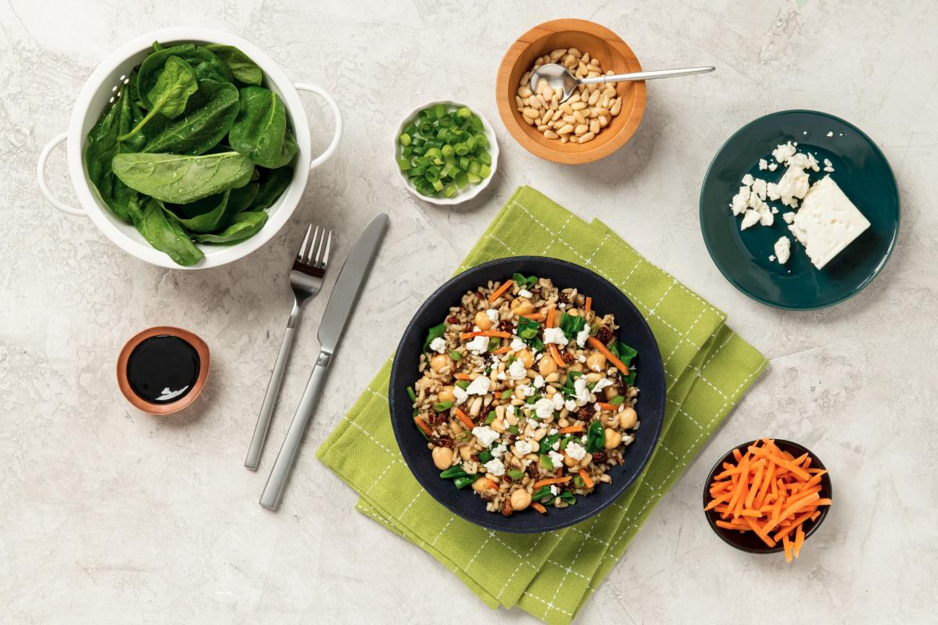


Healthy planet
Thriving people
Nourishing well-being
BETTER FOOD TODAY.
A BETTER WORLD FOR TOMORROW.
Notes:
Bonjour a tous nous sommes très heureux d’être présents aujourd’hui pour répondre à une problématique lancé par la marque Seeds of Change

Slide 2
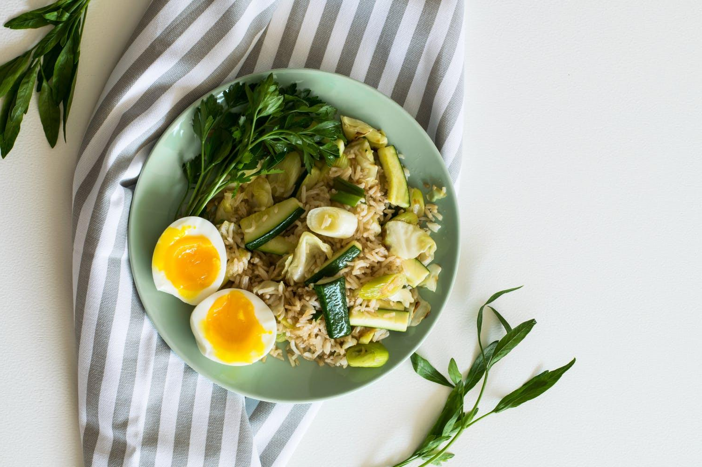
How could we help people to easily cook in a healthy & organic way
at home a meal they ate at restaurant ?
Our
Challenge
Notes:
Notre Challenge est le suivant : comment aider les gens a cuisiner simplement à la maison les plats sains qu’ils ont mangé au restaurant

Slide 3
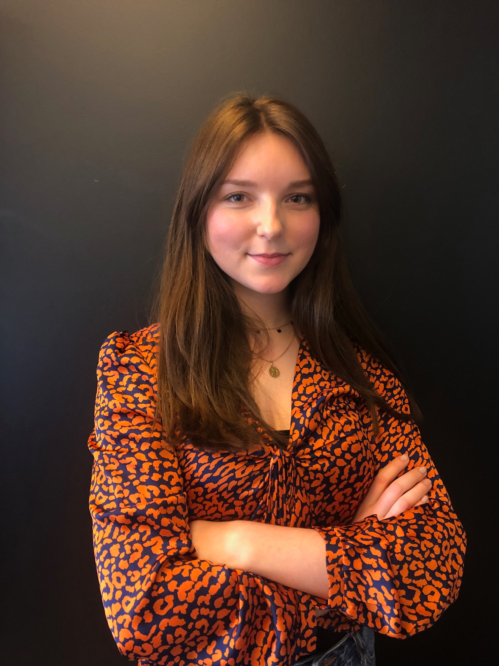
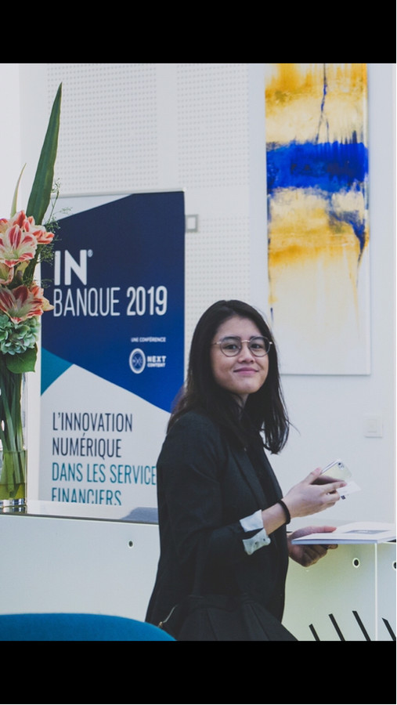
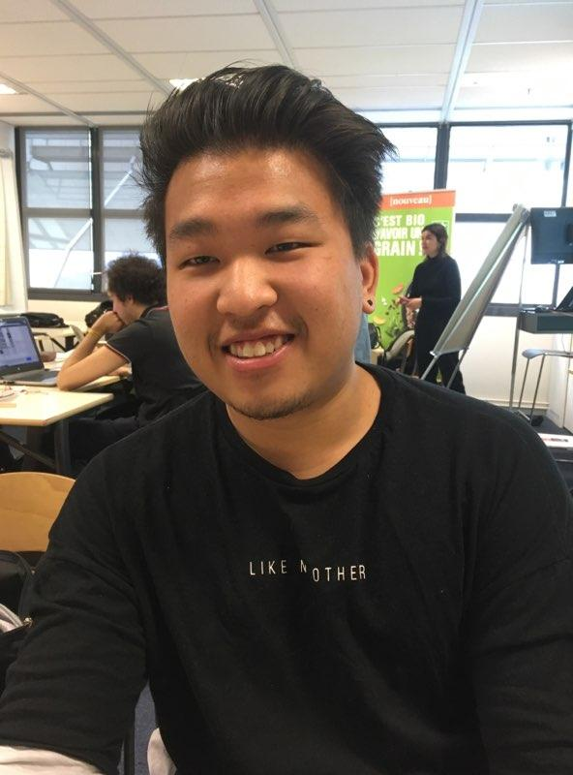
Our team
JULIEN
SANGAVY
AUDREY
PRISCA
ALVYN
Notes:
Bonjour à tous, voici donc les 2 problématiques identifiés pour les potentiels consommateurs. et sur lesquelles nous avons travailler avec mon équipe

Slide 4
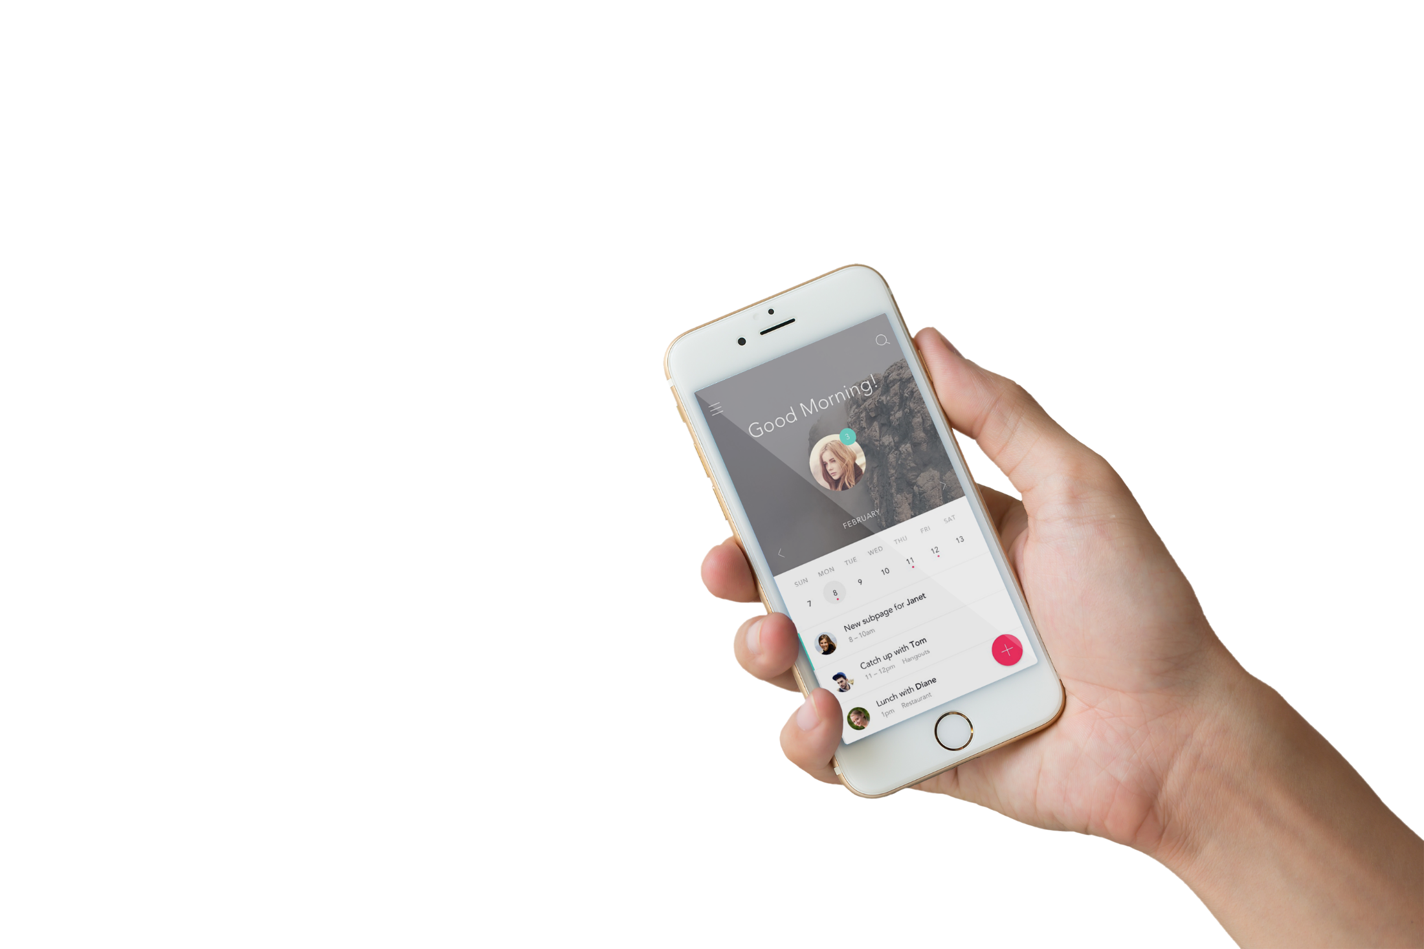

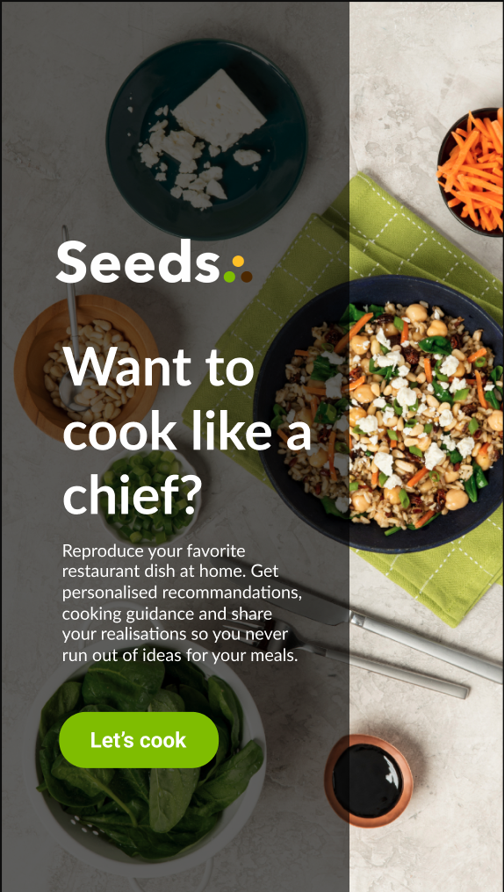
Want to cook like
a chef?
Concept
Reproduce your favorite restaurant dish at home. Get personalised recommendations, cooking guidance and share your realisations so you never run out of healthy ideas for your meals.
Notes:
La solution qu’on vous propose aujourd’hui est une application mobile qui s’appelle Seeds et qui vous permettra de reproduire des plats sains à la maison, obtenir des recommandations et être guider dans leur réalisations.

Slide 5



BUSINESS MODEL
Value proposition:
Visual recognition
Voice recognition
Community
Unique recipes
Personalized experience
Recommendations
Actors :
Brand
Distributor
User/Customer
Mobile application
In React Native
Available on Android & iOS
Notes:
notre application répond àe la fois aux besoins de votre marque, des distributeur et des consommateurs via une application liée a une technologie innovante tout en apportant une valeur ajoutée

Slide 6

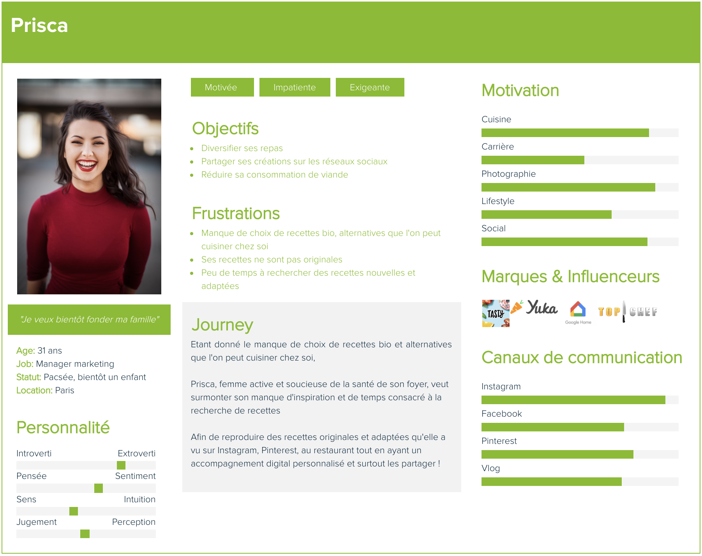

Slide 7

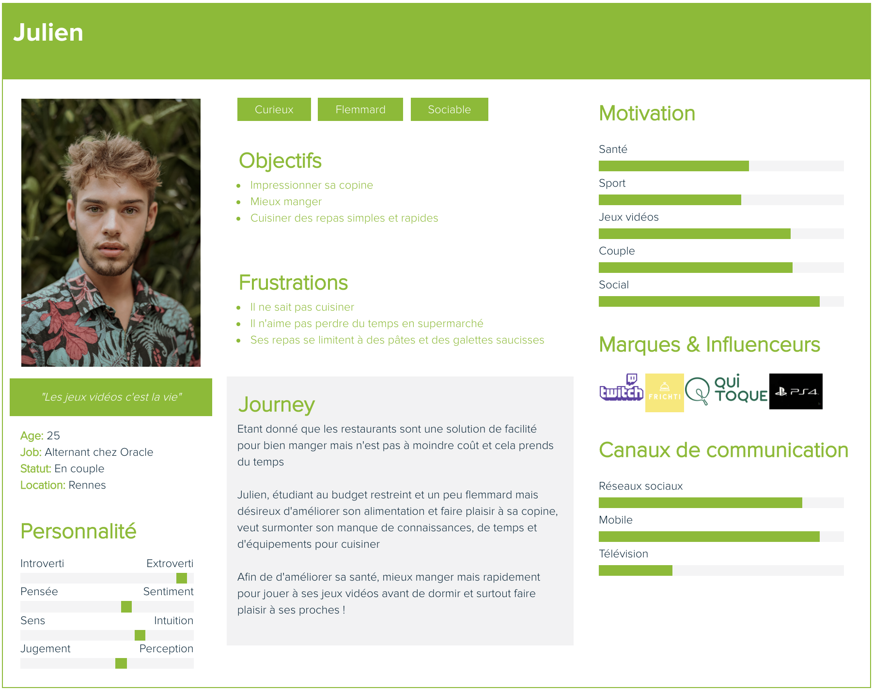

Slide 8
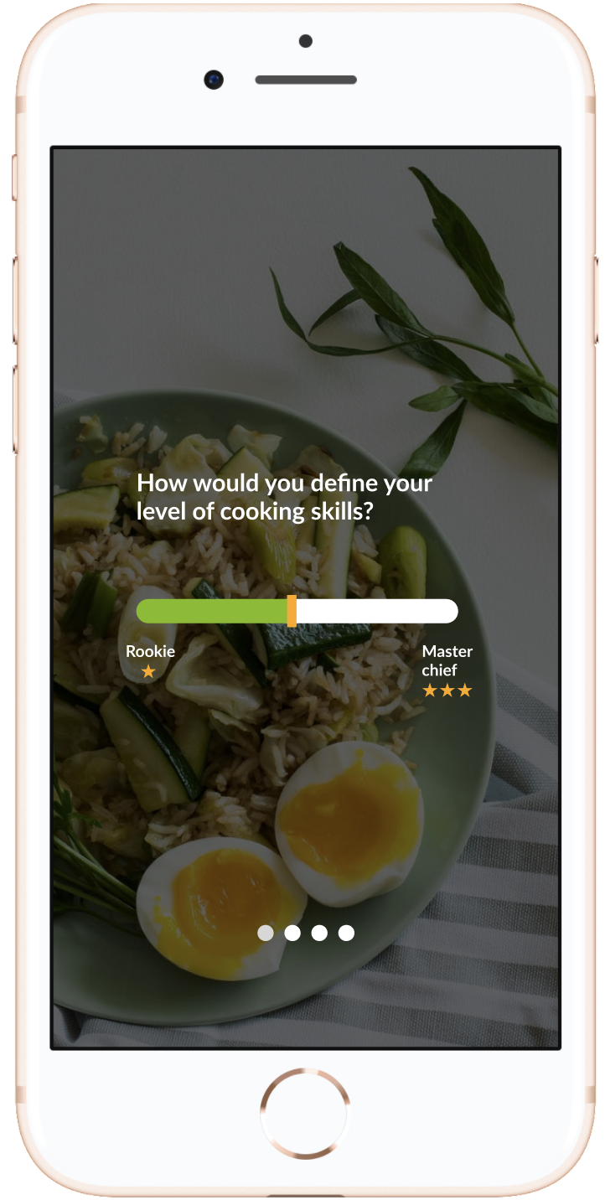
Select your level of cooking
DEFINE
MY PROFILE
Define your eating habits
Pick your equipments

Slide 9
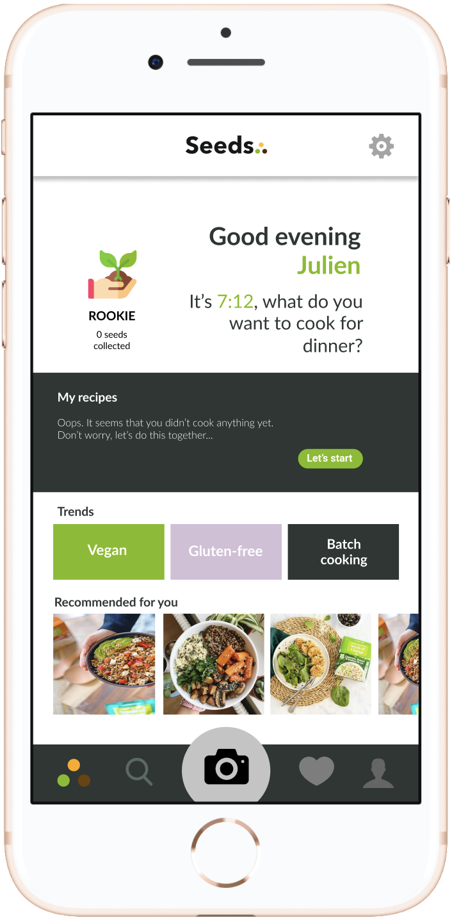
Suggest unexpected meals
CENTRALIZE
MY DATA
Recommend popular meals
Check and convert your fidelity grains

Slide 10
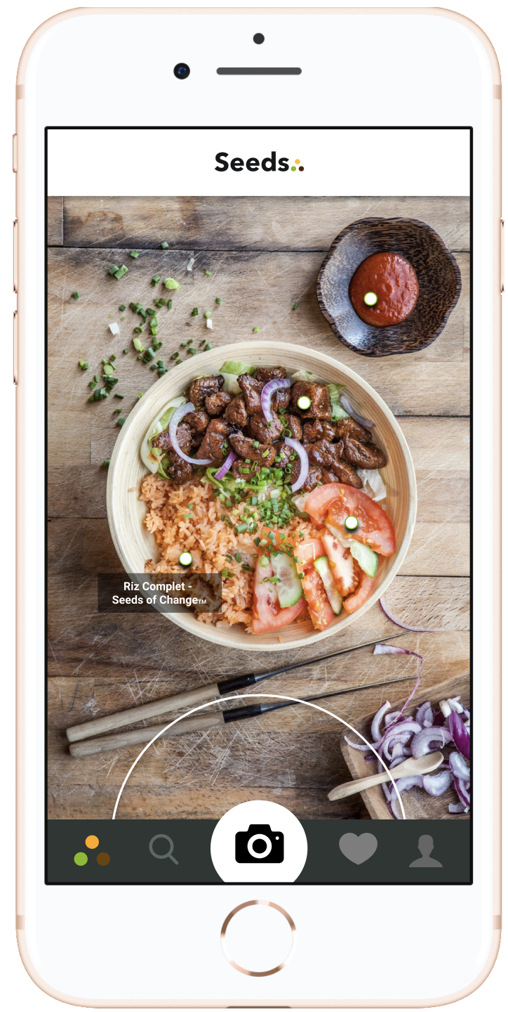


Capture a meal
RECOGNIZE
DELICIOUS
FOOD
Seeds analyses it for you
Choose the most appropriate recipe

Slide 11
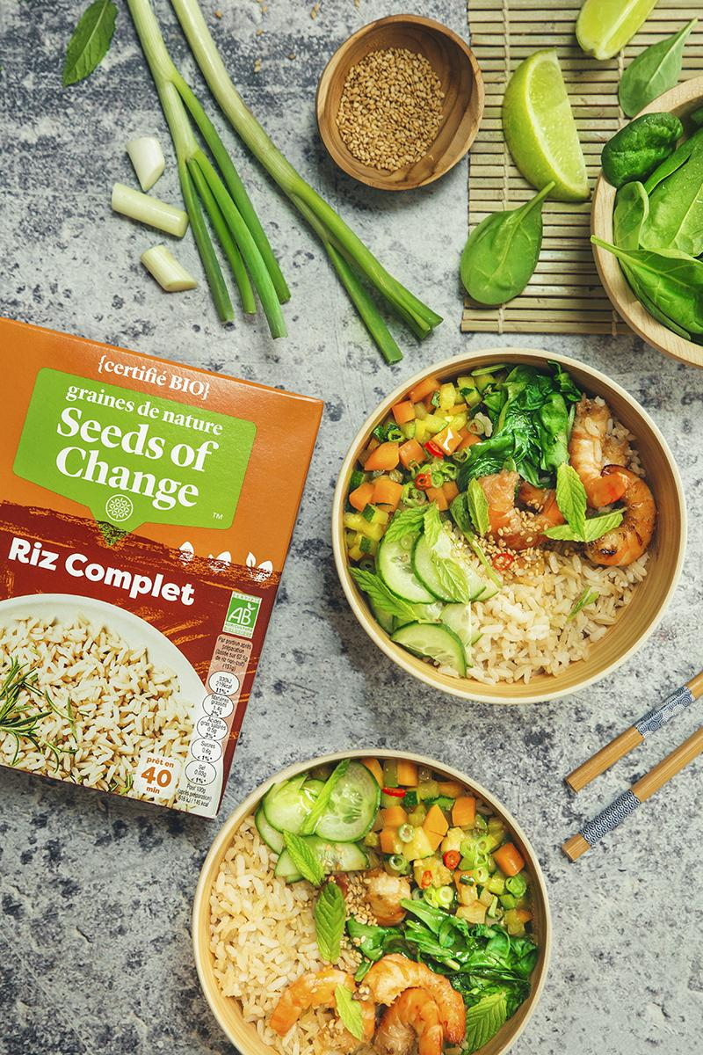

Find the ingredients
CHECK
MY RECIPE
Get guidance to
realise your meal
Share your meal and collect fidelity seeds

Slide 12
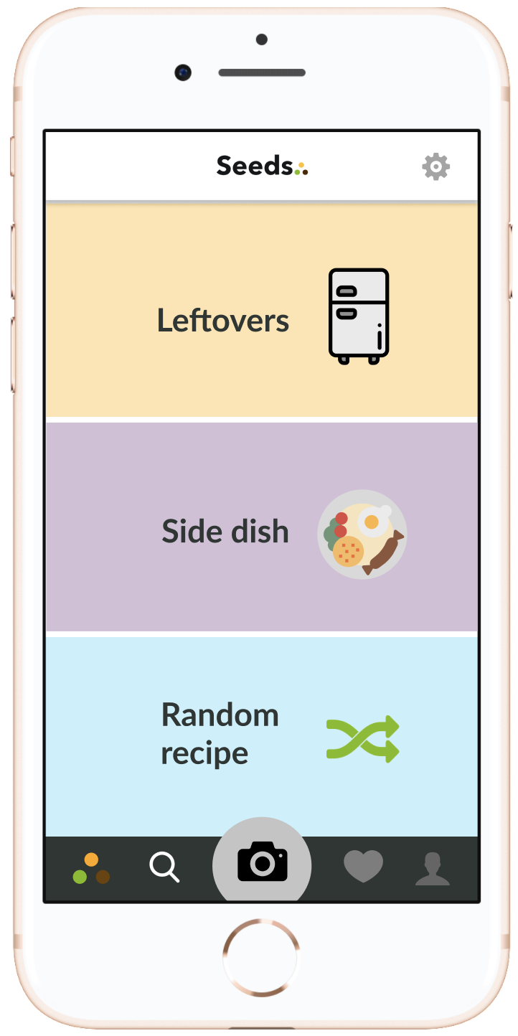
Select your favorite recipe
CHOOSE A RECIPE
Meet your perfect soulmate
Foodpairing with blockchain technology
Leftovers
What is in your fridge ?
Notes:
ebook

Slide 13
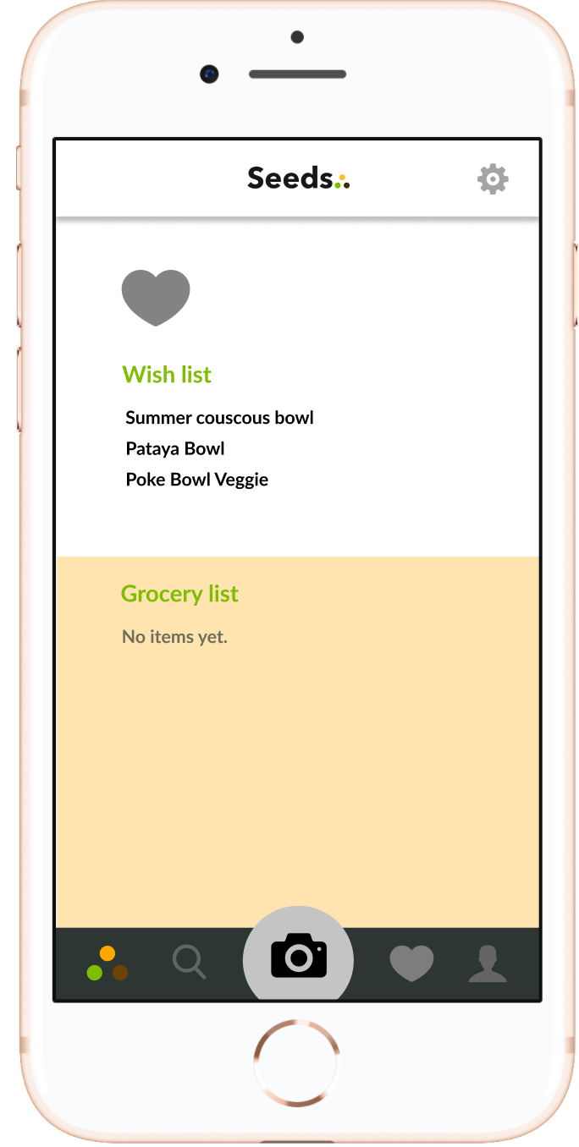
Create your wishlist
COLLECT
MY RECIPES
Read your ebook recipes
Prepare your shopping list
Notes:
ebook

Slide 14
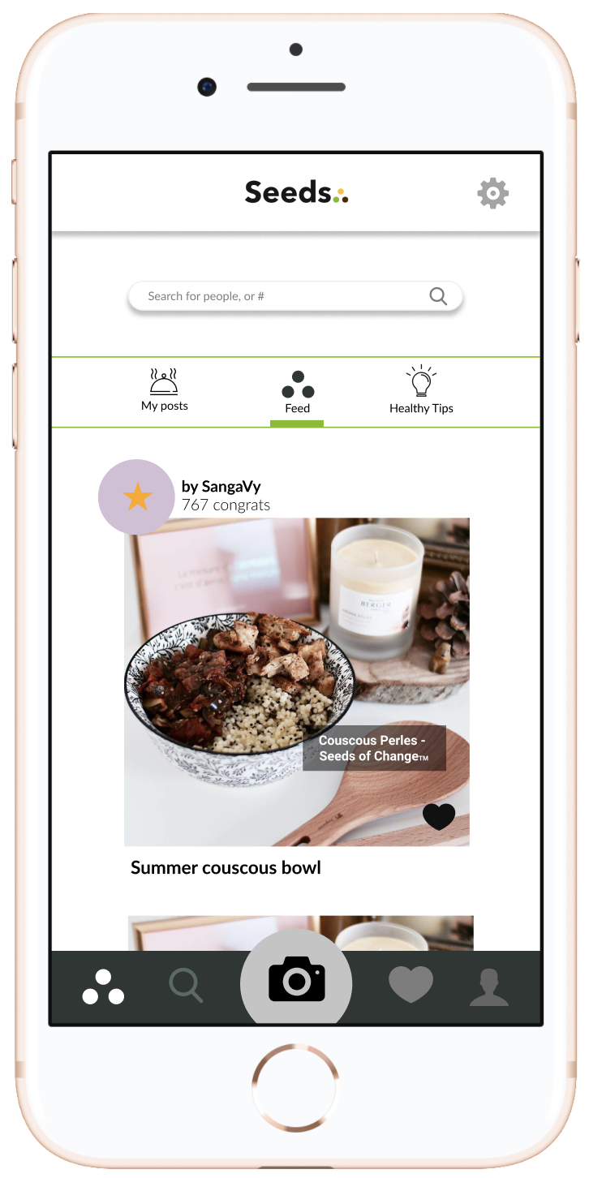
Build your online community
SHARE
MY DINNER
Follow other Seeds lovers
Find inspiration

Slide 15
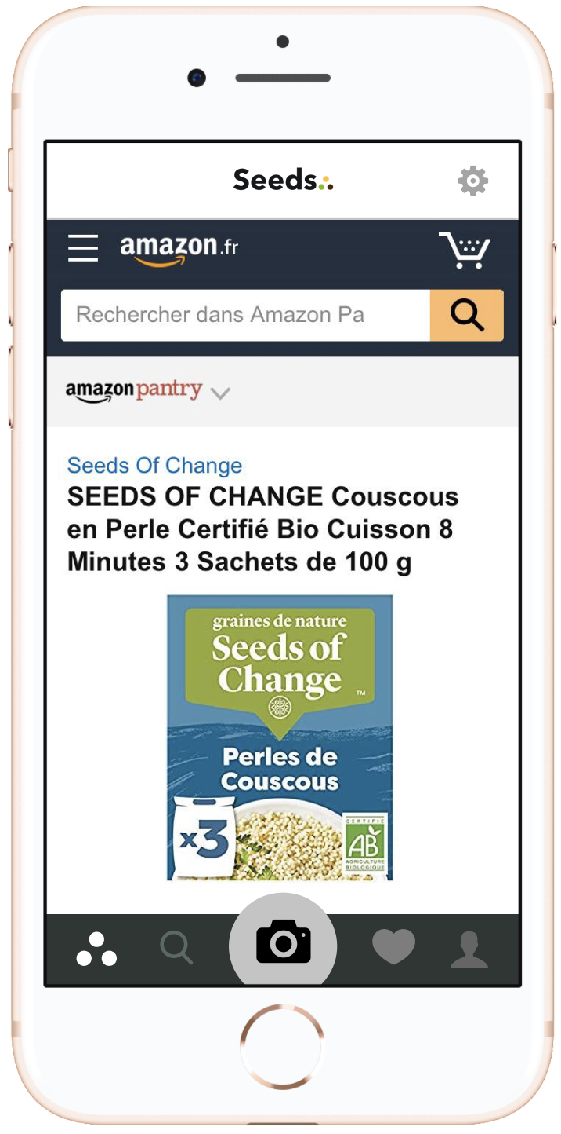

Find your shopping list
PREPARE
YOUR DINNER
Click on ingredients
Buy with Amazon or online supermarkets

Slide 16
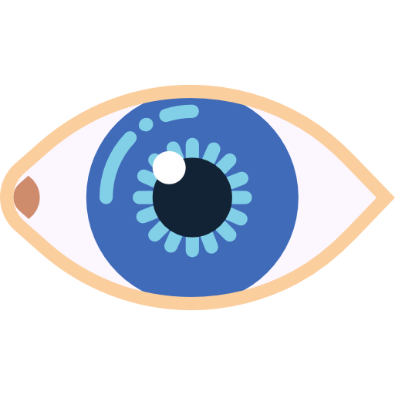
Image Recognition
WHICH
TECHNOLOGY?
How we’ll do it
AI with convolutional neural networks
Collect as many food dishes photographies as possible
Have pilot users (internal & external > target millenials), test it with feedback collection
Collect recipes associate to dishes
Image distortion and perspective manipulation
Correct > continuous improvements
Algorithm to calculate the correlation of images
Drive the solution

Slide 17
Vocal Synthesis and Voice Recognition
WHICH
TECHNOLOGY?
How we’ll do it
AI with convolutional neural networks
Collect as many sentence formulations as possible
Have pilot users (internal & external > target millenials), test it with feedback collection
Transcribe manually
(Speech to text)
Make a tree of dialogues with intentions / entities
Correct > continuous improvements
Transcribe the text into voice
(Text to speech)
Drive the solution

Slide 18





OUR PARTNERS

Slide 19
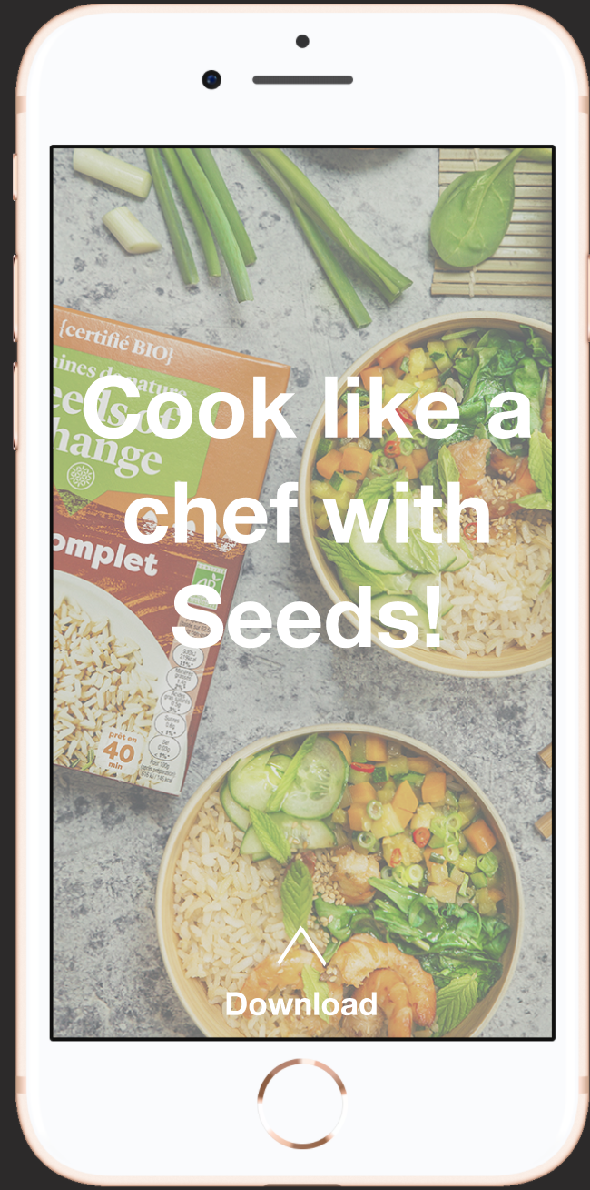



OUR SOCIAL NETWORKS
Sponsored Stories and publications

Slide 20


TV SHOWS

Slide 21
HOW WE HELPED
Based on a true story...
Julien’s girlfriend is now really impressed by his cooking skills and new healthy habits
Prisca never runs out of ideas for her meals and can reproduce (and adapt) her favorite healthy dishes
Notes:
Grâce a Seeds, La petite amie de julien est aujour’dui très impressionné par les talents culinaires de Julien et heureuse de diner autre chose que des coquillettes jambon.
Quant a Prisca, elle n’est jamais a cours d’idées et trouve facilement des produits et recettes saines adaptées à son régime alimentaire

Slide 22
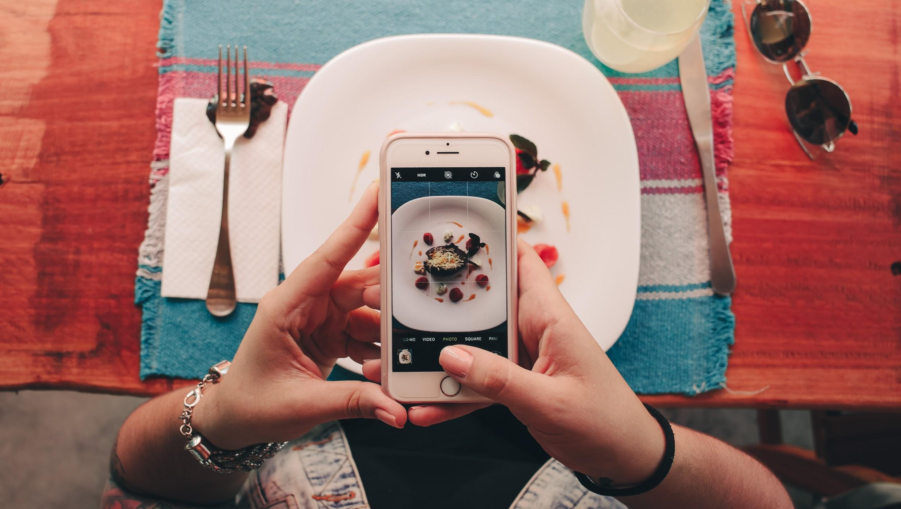
THANK YOU !

